Slide 1
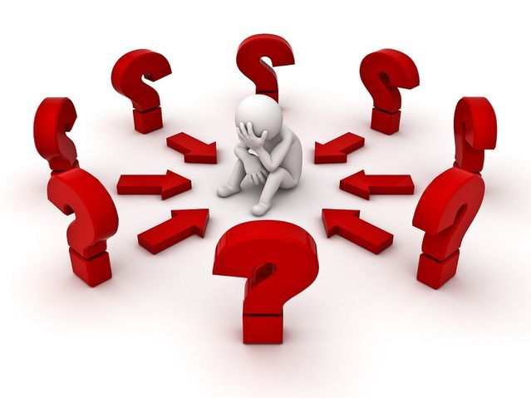
Victory Over Self Through Negative Emotions

Slide 2
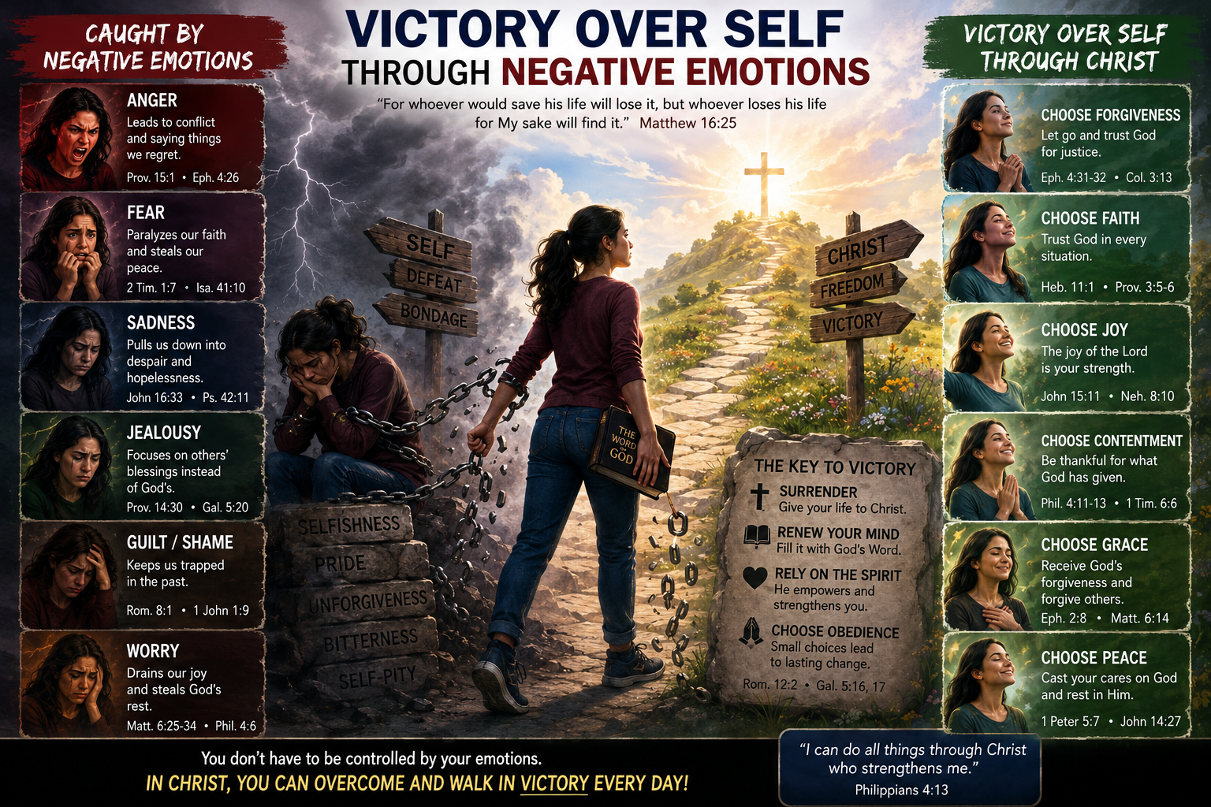
Notes:
It is sometimes optimistic to look at the end result.
The topic of emotions is getting a lot of traction, mainly due to the fact that there is a lot of research and awareness now about the emotions of humanity, and behaviour.

Slide 3
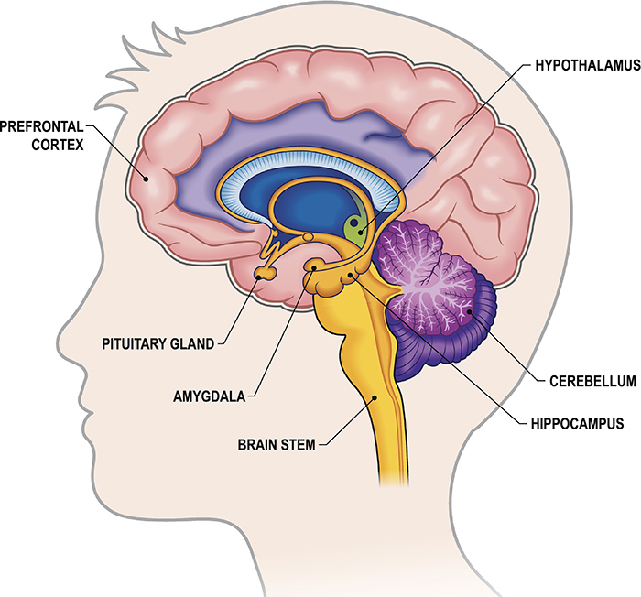
The Limbic System
Notes:
Emotions are complex physical and mental response patterns. Emotions do not live in one single spot. They come from a connected network deep inside the brain called the limbic system.
The limbic system is a group of connected structures deep inside the brain that manage emotions, memory, hunger, and basic drives.

Slide 4
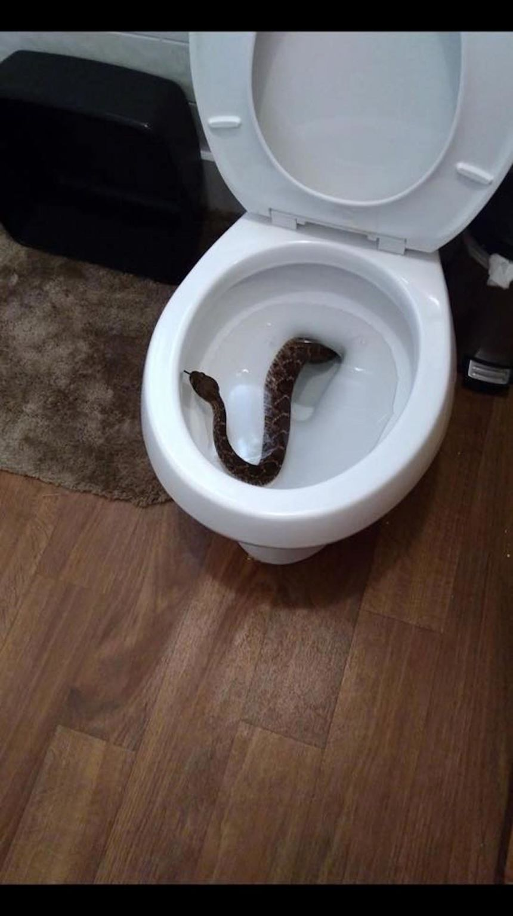
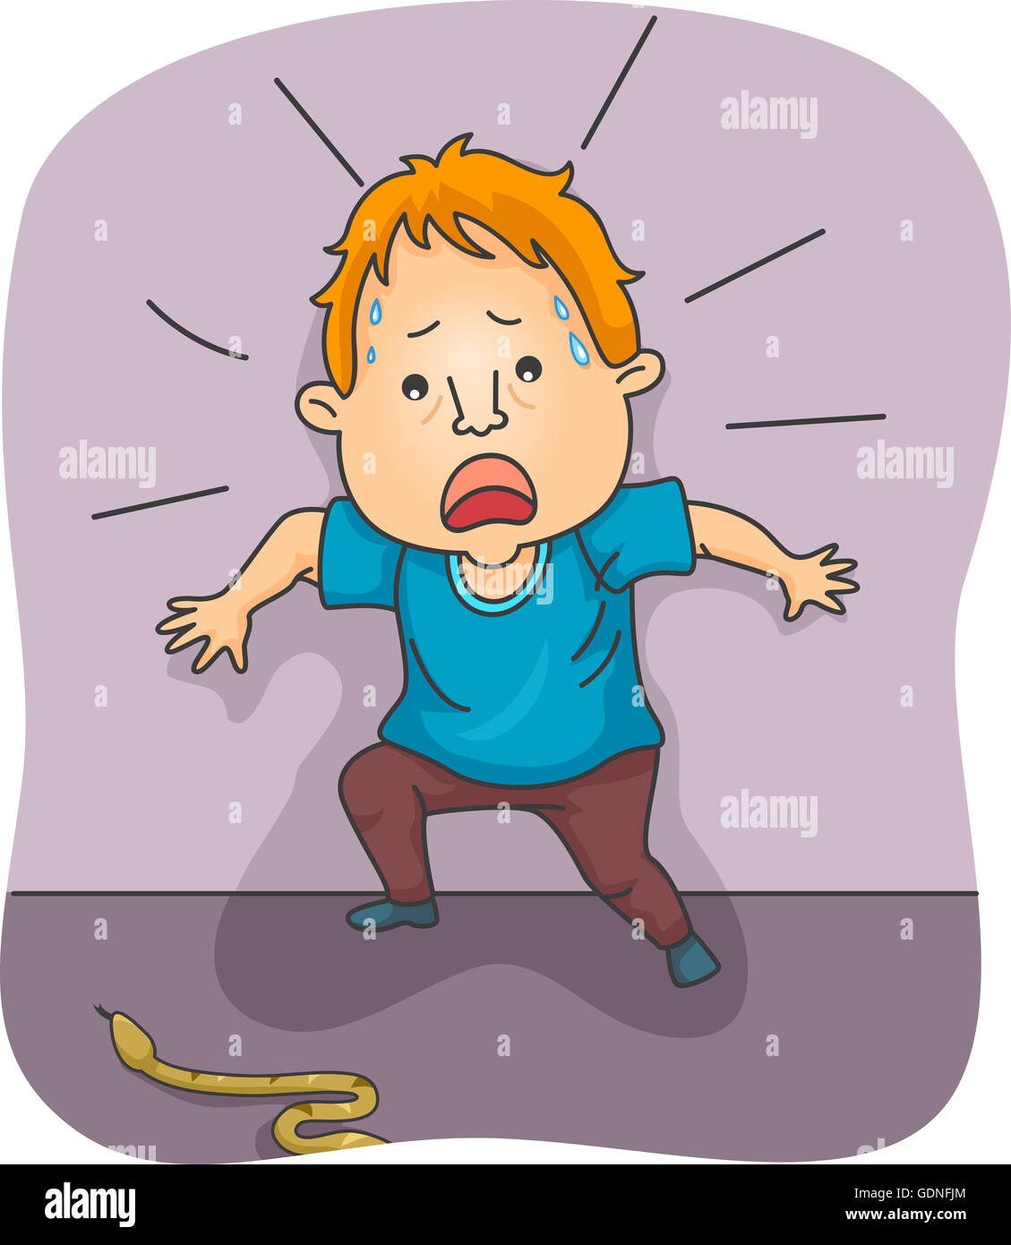
Notes:
If for example you see a snake in your path, a series of signals immediately and quickly work through the limbic system. Your sight sends signals to your emotional centre. You are alerted to danger and you might scream. Adrenaline is produced, you become tense in preparation for flight or fight. Memory now stored that produces fear, and you might avoid that path forever.

Slide 5
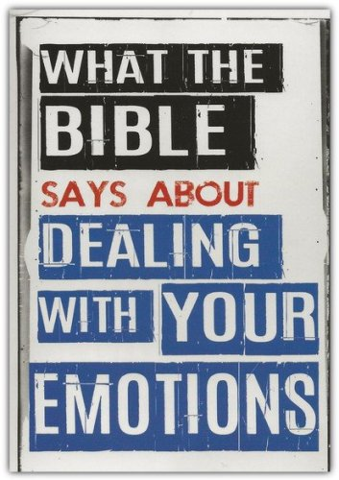
Notes:
The Bible does not give a single dictionary-style definition of emotion, but Scripture presents emotions as inner responses of the heart, mind, and soul to what a person perceives, believes, values, remembers, or experiences.
Emotions are real and significant, but Scripture shows that they are not always reliable guides to truth or conduct.

Slide 6
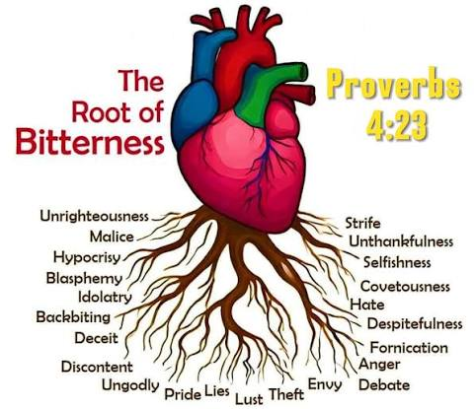
Notes:
Pro 4:23 Keep thy heart with all diligence; for out of it are the issues of life.
Mar 7:21 For from within, out of the heart of men, proceed evil thoughts, adulteries, fornications, murders, Mar 7:22 Thefts, covetousness, wickedness, deceit, lasciviousness, an evil eye, blasphemy, pride, foolishness: Mar 7:23 All these evil things come from within, and defile the man.
Within the heart/brain can be found the emotions.

Slide 7
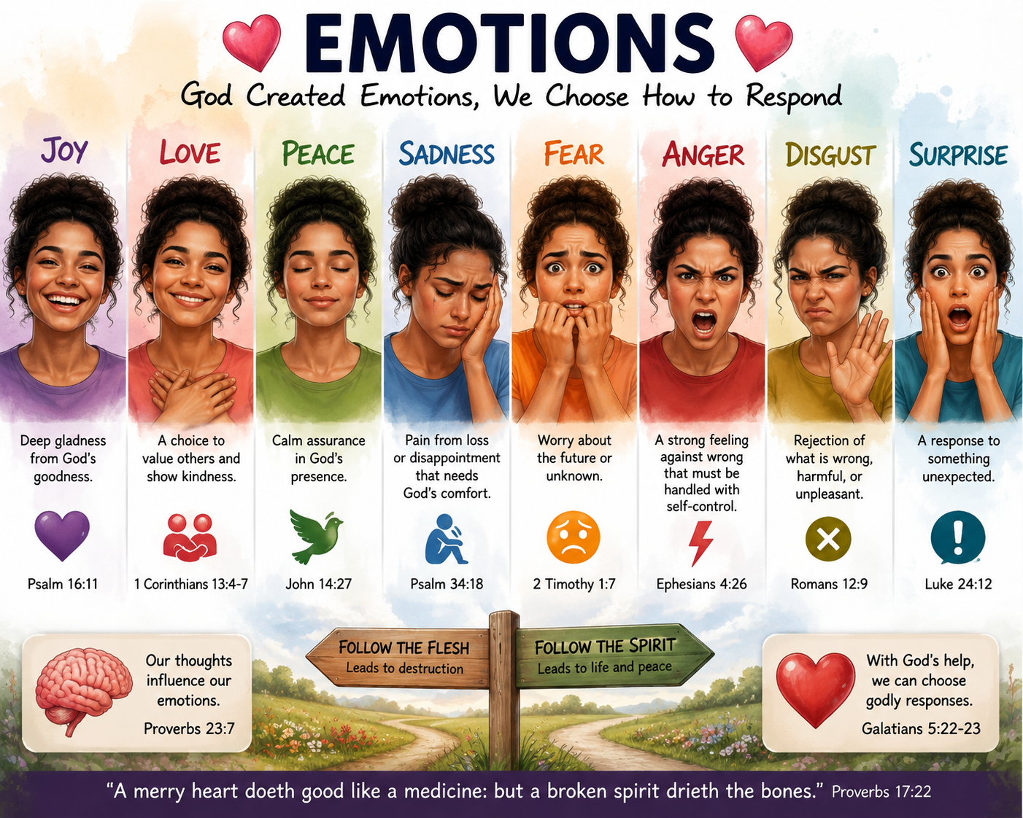
Notes:
There are of course good and bad emotions. We naturally crave to have only good emotions, but they are elusive and few. But bad emotions we shun, or gotten rid of.

Slide 8
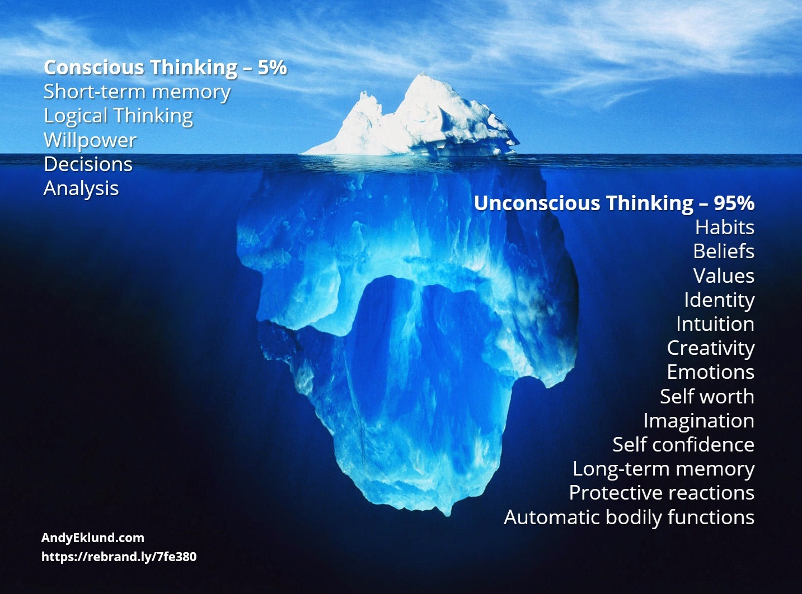
Notes:
It is in the subconscious mind that these negative emotions reside. Under the hood so to speak.
Remember we have a 5%-95% brain ratio comprising the conscious and sub-conscious. Explain.

Slide 9
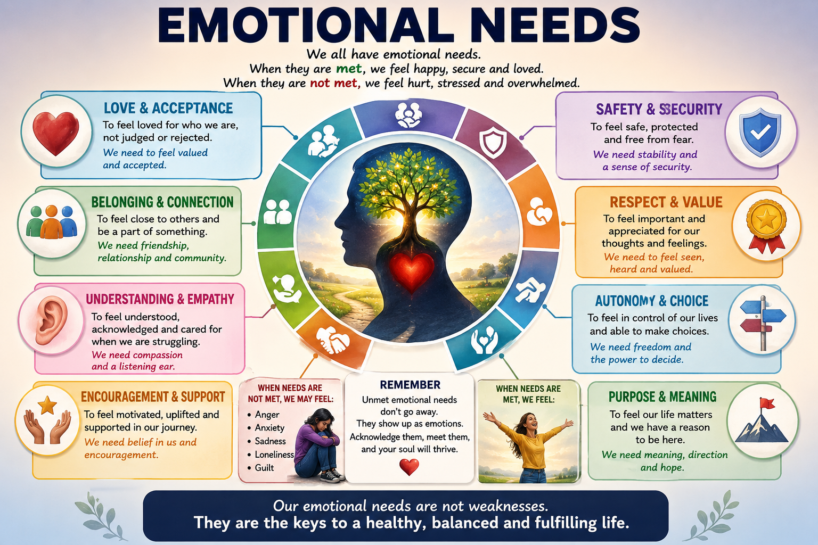
Notes:
Connected with our emotions are our emotional needs that we have. Depending on how they are met or not met, determines our emotion to a great degree.
And here is where we need victory. We cannot get into the kingdom without mastering our emotions by the grace of God. A holy temper is achievable.
Emotional needs are feelings or conditions we need to feel happy, fulfilled, or at peace. Without them, we may feel frustrated, hurt, or dissatisfied.
Some examples of emotional needs might include feeling appreciated, feeling accomplished, feeling safe, or feeling part of a community. Safety and security, love and belonging, autonomy and control, validation, recognition, understanding, significance esteem and competence, certainty, love/connection, significance, and a sense of purpose.

Slide 10
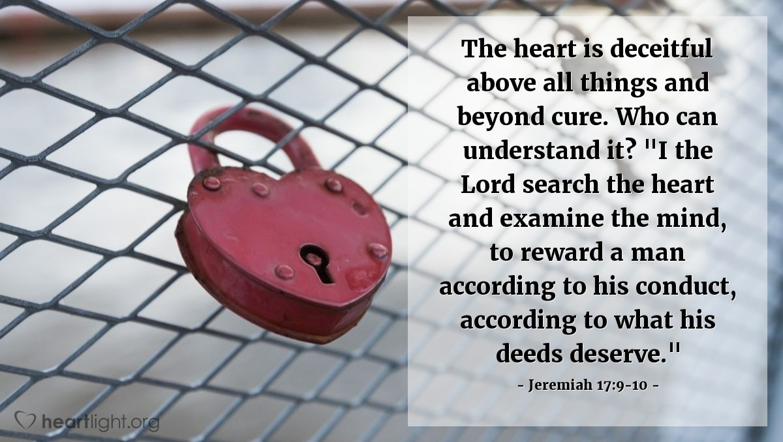
Notes:
We do not know our hearts. They are deceitful above all things.
Jesus wants us to need what He has to give. We were created that way.
Php 4:19 But my God shall supply all your need according to his riches in glory by Christ Jesus.

Slide 11
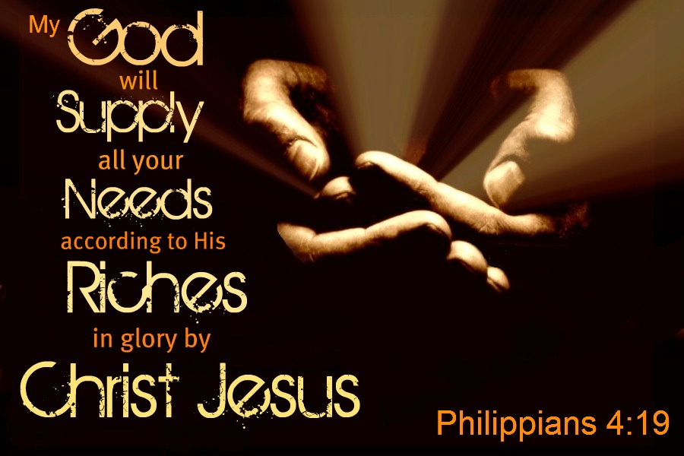
Jesus wants us to need what He has to give
Notes:
We were created that way.

Slide 12

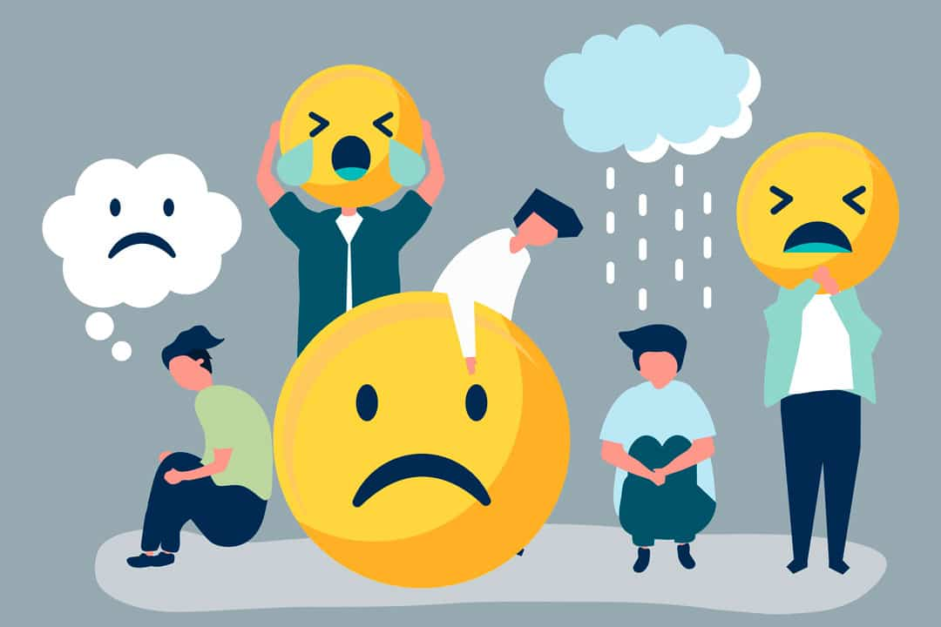
Notes:
If these are not met, all different types of negative emotions can arise.
This is where we need help. Remember, Jesus wants us to need what He has to give.
Very important.

Slide 13
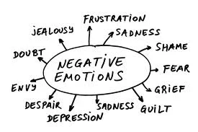

Slide 14
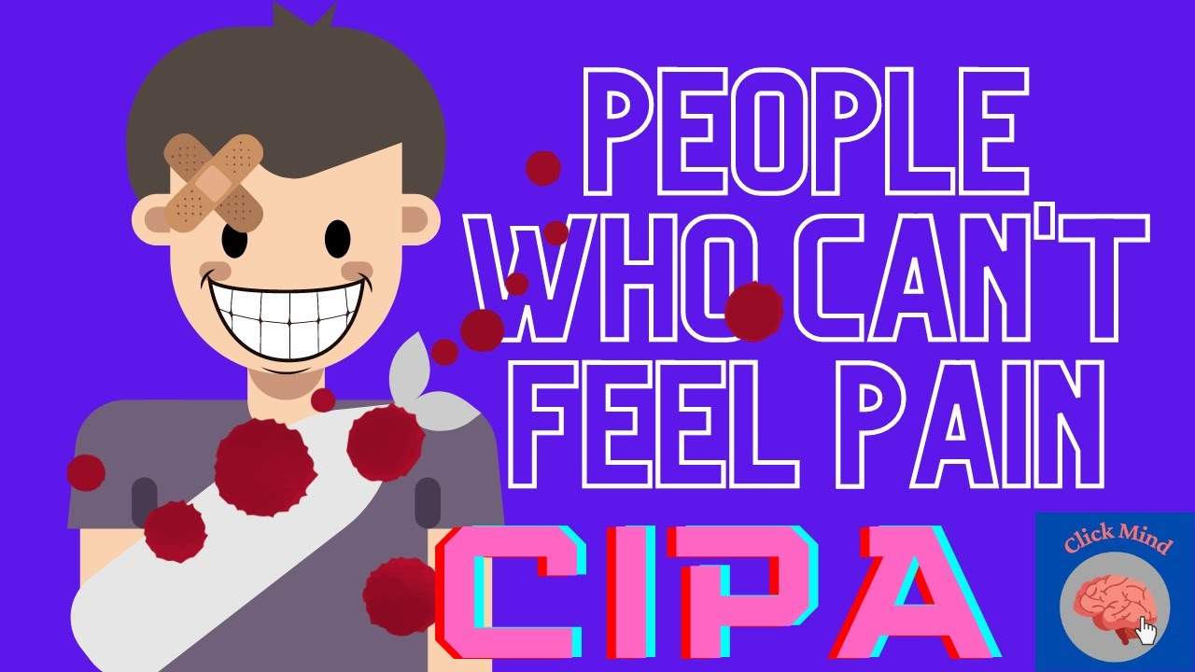
Notes:
Congenital Insensitivity to Pain and Anhidrosis (CIPA)
C.I.P.A. condition. The inability to feel pain. Could you imagine you could not feel pain? You would be damaging yourself over and over again. So too, the negative emotions they are under the hood to tell us something is wrong and needs immediate attention.

Slide 15
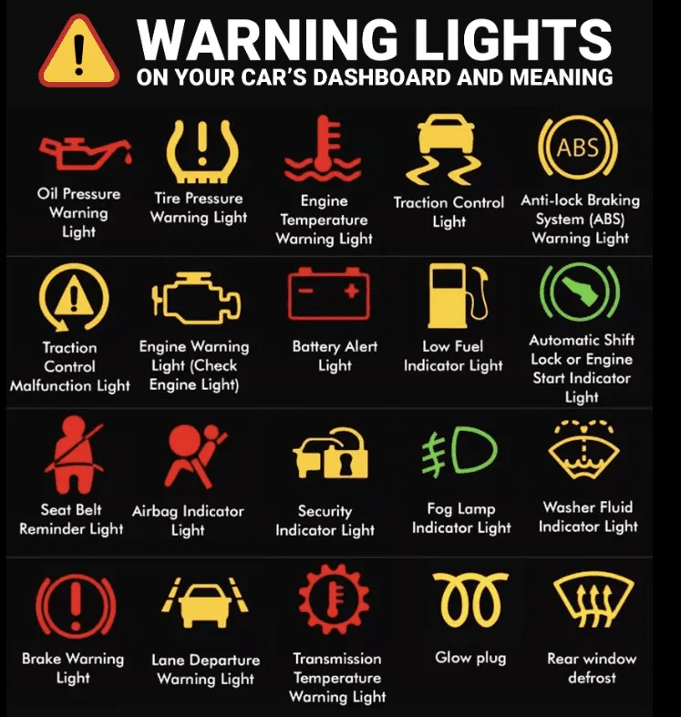
Notes:
What’s going on beneath your hood?

Slide 16
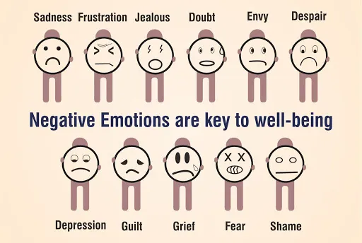
Notes:
Negative emotions are in all of us for a particular reason. It is for our victory over self.
List of negative emotions: Anger, despair, emptiness, frustrated, inadequacy, fear, guilt, loneliness, regret, resentment, sadness, jealousy, disconnection, not good enough, shame, blame, unworthiness, trapped and stuck.
Tells us that a need is not met. But we cannot get that need from the same old source of self.
Run to Jesus.
Again; Jesus want us to need what He has to give. Phil. 4:19

Slide 17
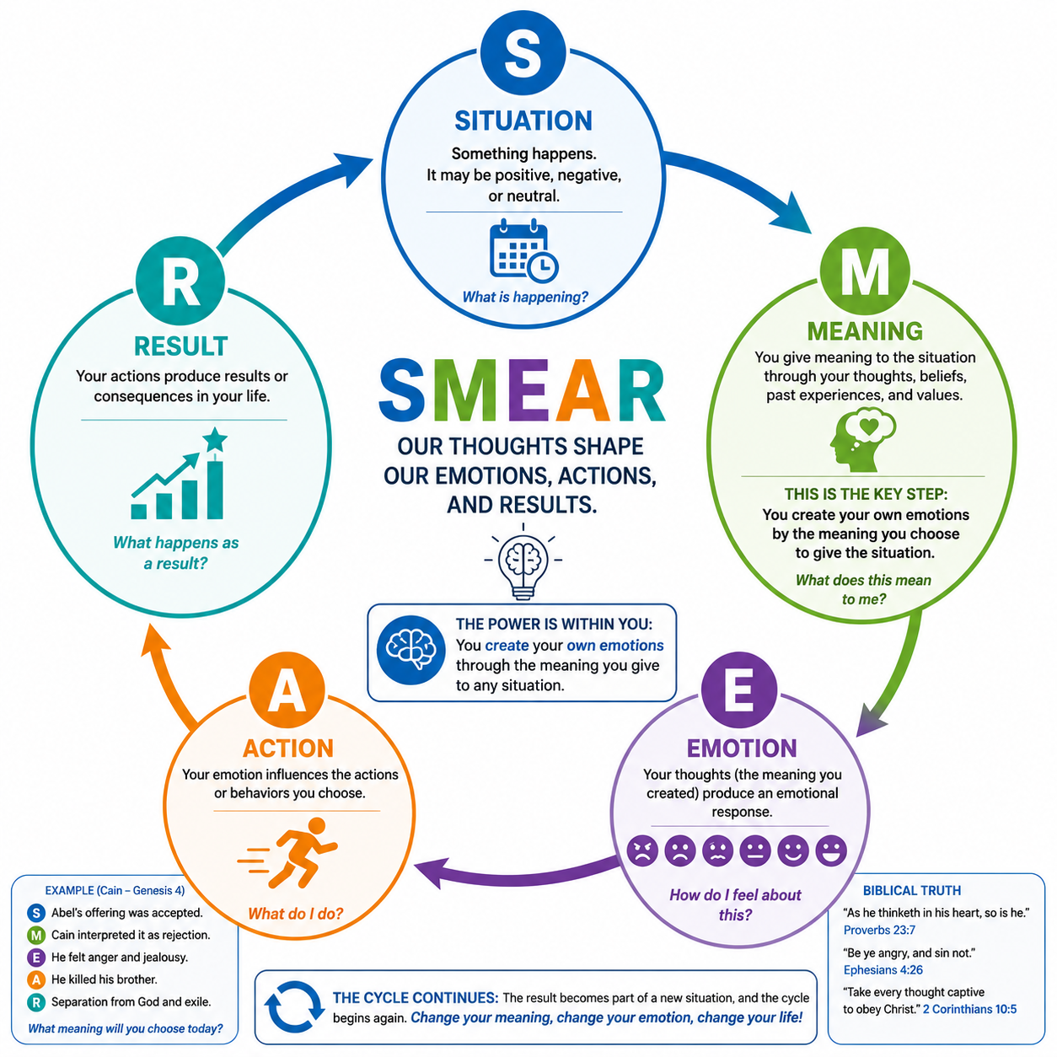
Notes:
Look at the chart and explain. Where do negative emotions come from? They are created by us when meaning is placed on a thought. We create our own emotions.

Slide 18
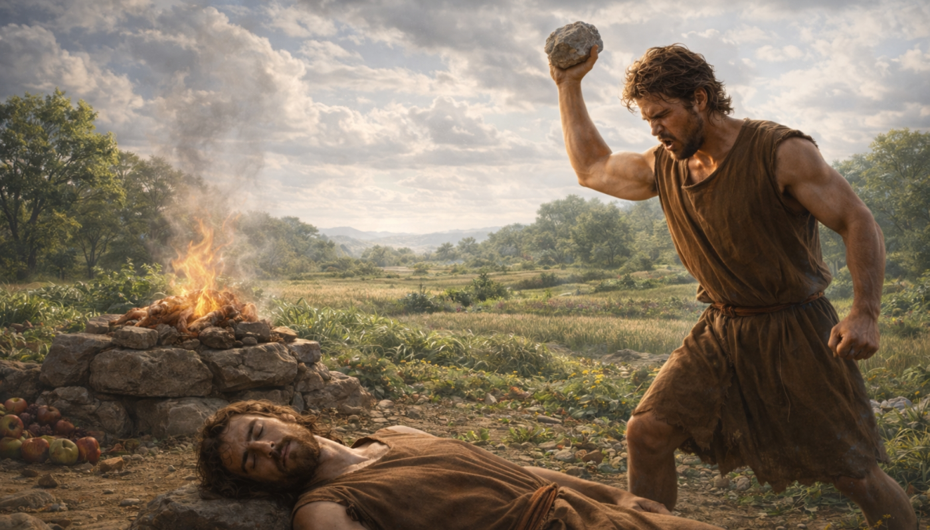
Cain and Abel
Notes:
Biblical Person: Cain — Gen. 4:3–8
Situation: Abel's offering was accepted.
Meaning: Cain interpreted this as rejection and personal humiliation.
Emotion: Anger and jealousy.
Action: Cain killed his brother.
Result: Separation from God, judgment, and exile.

Slide 19
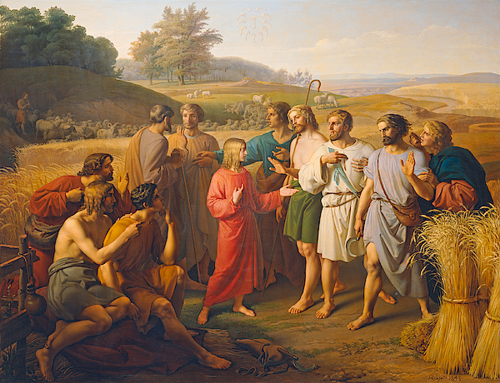
Notes:
Biblical Persons: Joseph's brothers — Gen. 37:3–28
Situation: Joseph received special favor and dreamed of ruling
Meaning: “He is going to rule over us.”
Emotion: Envy, hatred
Action: Sold Joseph
Result: Perpetual stain upon their consciences

Slide 20
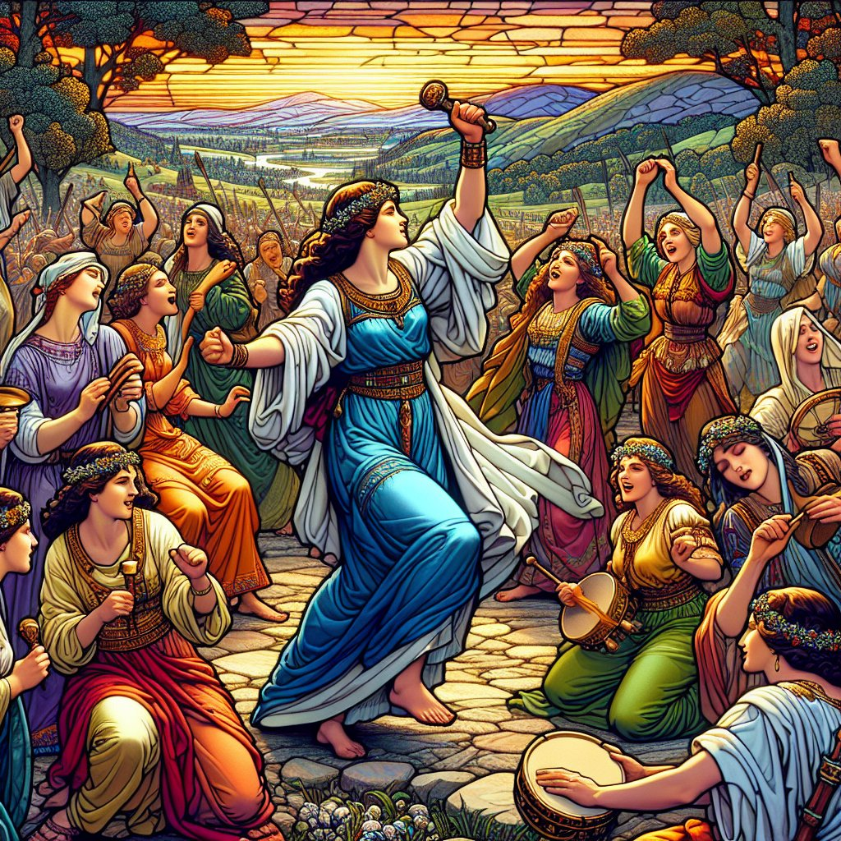
1Sa 18:6 And it came to pass as they came, when David was returned from the slaughter of the Philistine, that the women came out of all cities of Israel, singing and dancing, to meet king Saul, with tabrets, with joy, and with instruments of musick.
1Sa 18:7 And the women answered one another as they played, and said, Saul hath slain his thousands, and David his ten thousands.
1Sa 18:8 And Saul was very wroth, and the saying displeased him; and he said, They have ascribed unto David ten thousands, and to me they have ascribed but thousands: and what can he have more but the kingdom?
Notes:
Biblical person: Saul — 1 Sam. 18:6–12
Situation: Women praised David more than Saul
Meaning“They are giving David more honor than me.”
Emotion: Anger, jealousy, fear
Action: Tried to kill David
Result: Lost his mind, lost his kingdom, killed himself.

Slide 21
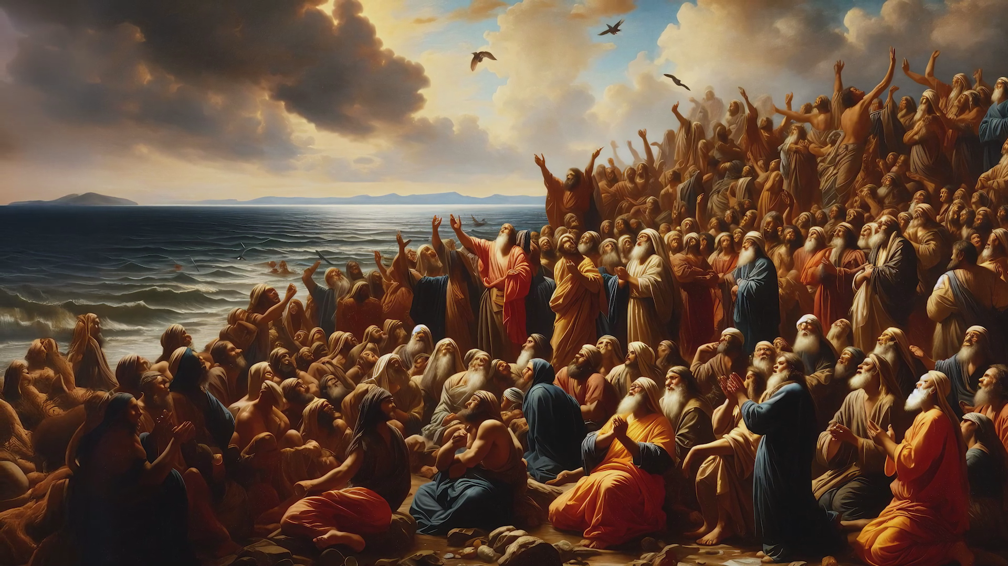
Notes:
When the children of Israel were cornered at the Red Sea. What meaning did they put to it? Exo 14:11 And they said unto Moses, Becau se there were no graves in Egypt, hast thou taken us away to die in the wilderness? wherefore hast thou dealt thus with us, to carry us forth out of Egypt?

Slide 22

2Co 10:3 For though we walk in the flesh, we do not war after the flesh:
2Co 10:4 (For the weapons of our warfare are not carnal, but mighty through God to the pulling down of strong holds;)
2Co 10:5 Casting down imaginations, and every high thing that exalteth itself against the knowledge of God, and bringing into captivity every thought to the obedience of Christ

Slide 23

Pro 23:7 For as he thinketh in his heart, so is he…
Eph 4:23 And be renewed in the spirit of your mind;

Slide 24

As A Man Thinketh In His Heart…
  The thoughts are not to be allowed to run riot. They must be restrained, brought into captivity to the obedience of Christ. Let them be placed upon holy things. Then, through the grace of Christ, they will be pure and true. We need a constant sense of the ennobling power of pure thoughts. The only security for any soul is right thinking. {FLB 222.4}

Slide 25
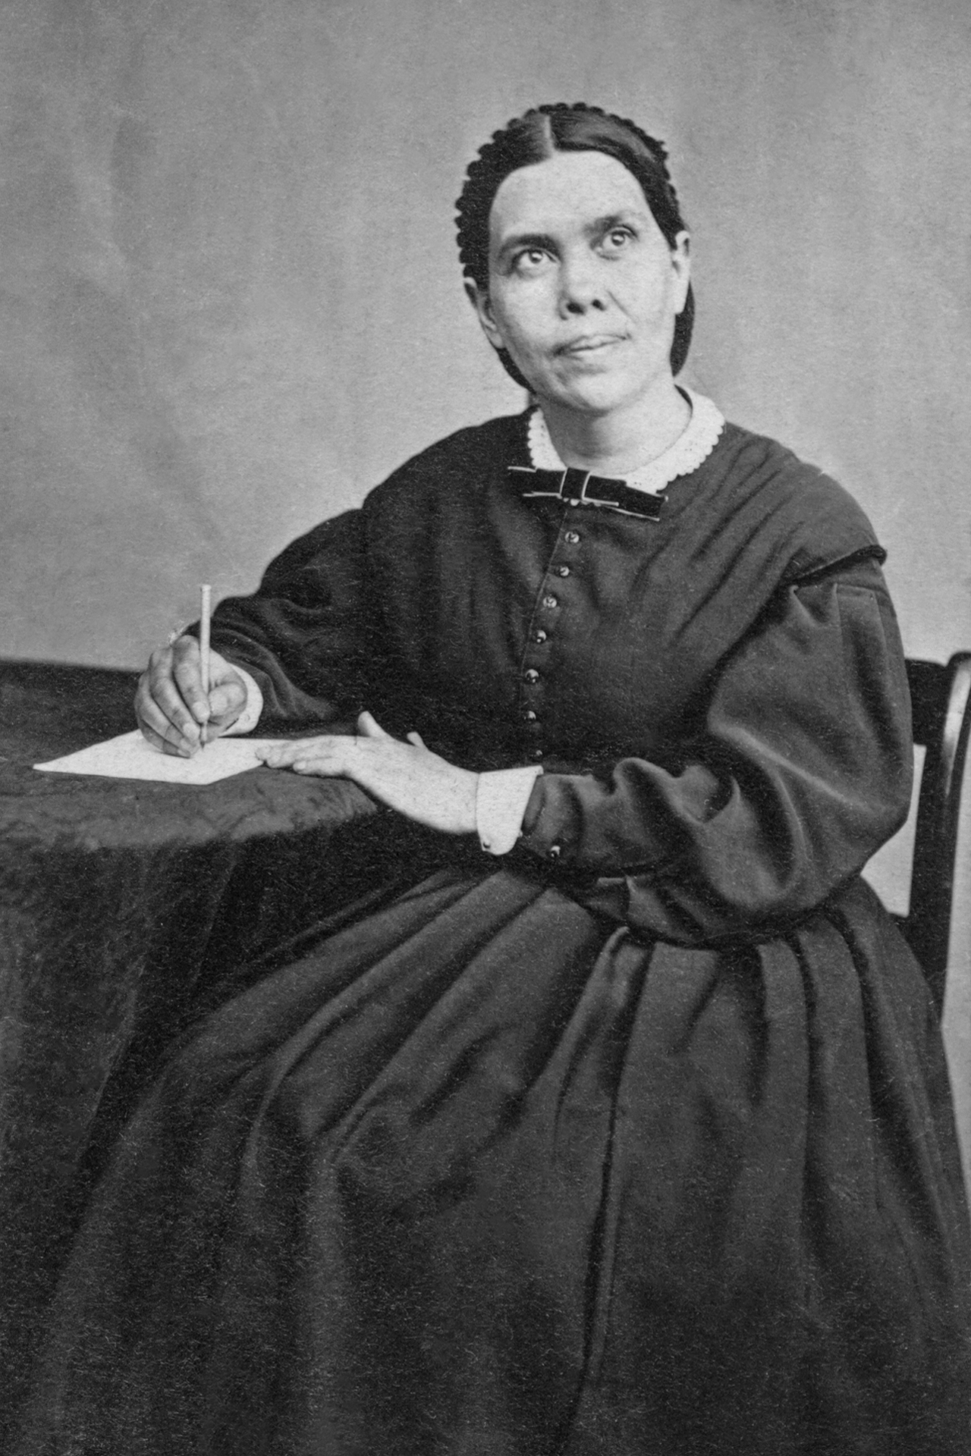
We must learn to place the best possible construction upon doubtful conduct of others. . . . If we are ever suspecting evil, we are in danger of creating what we allow ourselves to suspect. . . . We cannot pass along without sometimes having our feelings hurt and our temper tried, but as Christians we must be just as patient, forbearing, humble, and meek as we desire others to be. {2MCP 789.2}

Slide 26
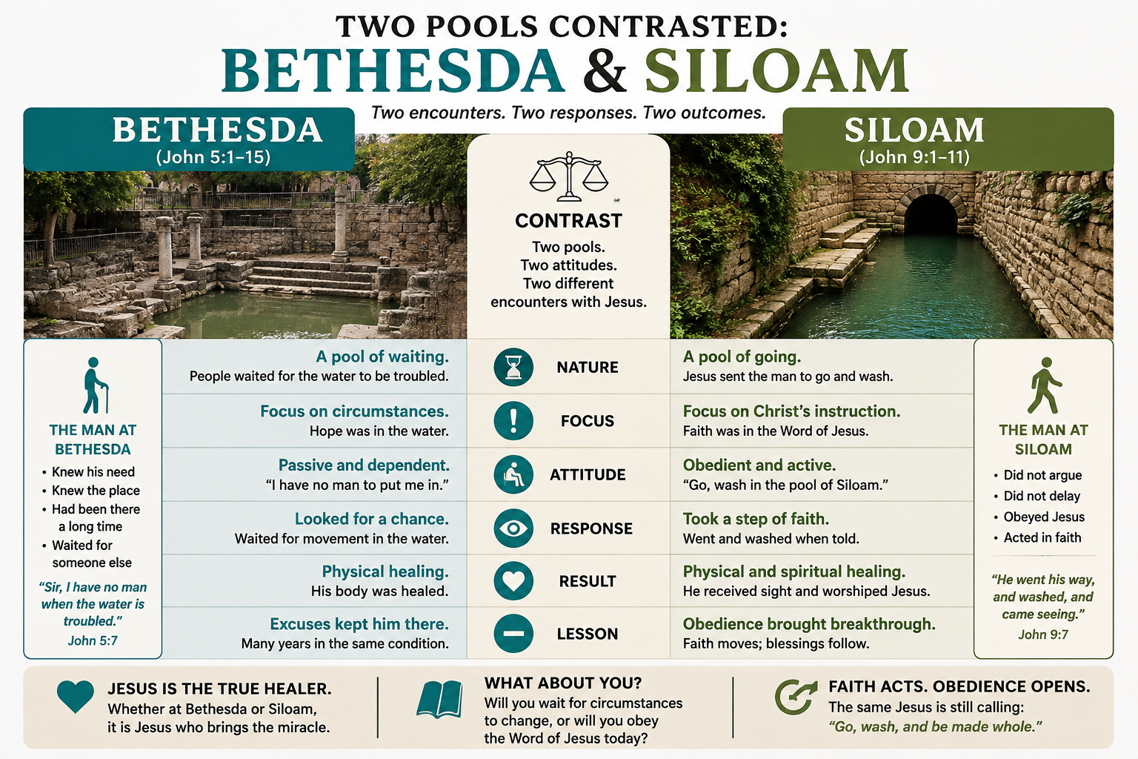

Slide 27
Notes:
It is sometimes optimistic to look at the end result.
The topic of emotions is getting a lot of traction, mainly due to the fact that there is a lot of research and awareness now about the emotions of humanity, and behaviour.

Slide 28

Notes:
Two kingdoms are contending for the same ground: your mind. Satan builds fortresses of lies and hardens them into habit; Christ pulls them down, fills the mind with truth, and leads every thought captive to Himself. The weapons for this war are mighty through God, you are not left to fight a steel-clad habit with bare hands.

